Slide 1


Airline Crew Operations Analytics and Business Intelligence
Presented by Madhura A. Indurkar
Masters in Integrated Manufacturing Systems Engineering
Summer 2018

Slide 2
Introduction
Crew Operations
Crew Planning
Operational Planning and Performance
Network Design and Optimization
Crew Strategy and Business Intelligence

Slide 3
Purpose and Scope of Project
Crew Operations
Problem: Operational Expenses were at an all time high during the business year 2016 and Q1 of 2017
Operations Planning and Performance
Crew Strategy and Business Intelligence
Planned Operational and Performance Metrics designed by the team
Analysis of operational and performance metrics, income, and strategy development
Goal
Analyze the variability between the planned crew operational metrics and actual values observed
Develop strategy to reduce variance

Slide 4
Variance Analysis of actual and planned crew operations metrics
Phase 1
Data Mining of Flight Trip Data
Phase 2
Data Preparation and Validation
Data cleaning, variable extraction and validation against two other datasets
Phase 3
Exploratory analysis and Visualization
Variance analysis on MS excel
Extraction of actual and planned crew operations metrics data using T-SQL

Slide 5
Airline Crew Operations Terminology
Crew
Lineholders – Pilot, co-pilot, flight attendants
Crew Base
Main resting location or residence
Reserves
Flight Leg
Journey of aircraft from takeoff to landing
Flight Trip
Single Legged - Base airport (A) to Destination (B)
Multi legged – Base (A) to multiple destinations, back to base. (A)->(B)->(C)->(A)
Base Airport (A) -> Destination Airport (B)

Slide 6
Airline Crew Operations Terminology
Flight Duty Period
Time of reporting of crew to time of sign off for rest (per leg)
Block
Total number of flying hours of crew
Deadhead
Journey of aircraft for the purpose of crew transportation without passengers (no income)
Rest over night
Number of nights spent by crew for rest, away from base
Number of legs = Number of duty periods
Block per leg – Takeoff to landing
Block of flight trip – Sum of block of all legs

Slide 7
Airline Crew Operations Terminology
Synthetic
Limitations on flying hours set by Federal Aviation Administration
Total salary of crew members = Hourly pay for block + Extra compensation (if FAA requirements not met)
Synthetic = Number of hours for which extra compensation provided
Rig
The number of hours for which crew members are awarded extra compensation, excluding the deadhead hours
Total Salary = Hourly pay for block hourly pay for (Rig + Deadhead) hours
Duty Period = Block + Synthetic
Synthetic = Deadhead + Rig

Slide 8
Phase 1: Mining of Flight Trip Data
Actual crew operations metrics
Actual flight trip data
Planned crew operations metrics
Planned flight trip data
Query 1
Query 2

Slide 9
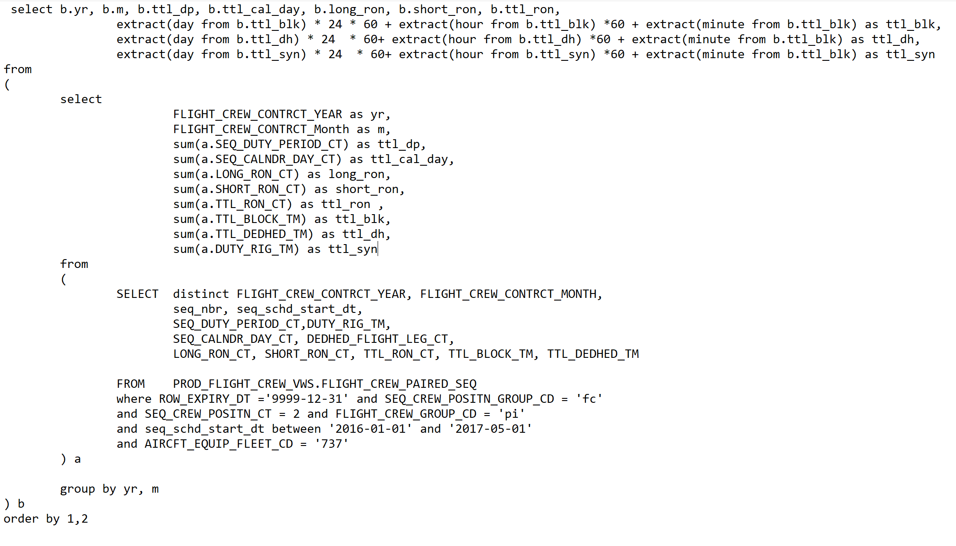
Query 1: Extraction of planned crew operations metrics
Relational Database view: PROD_FLIGHT_CREW_VWS
Table used: FLIGHT_CREW_PAIRED_SEQ
Parameters extracted
Conditions specified in Where clause
Variables created and format modified

Slide 10
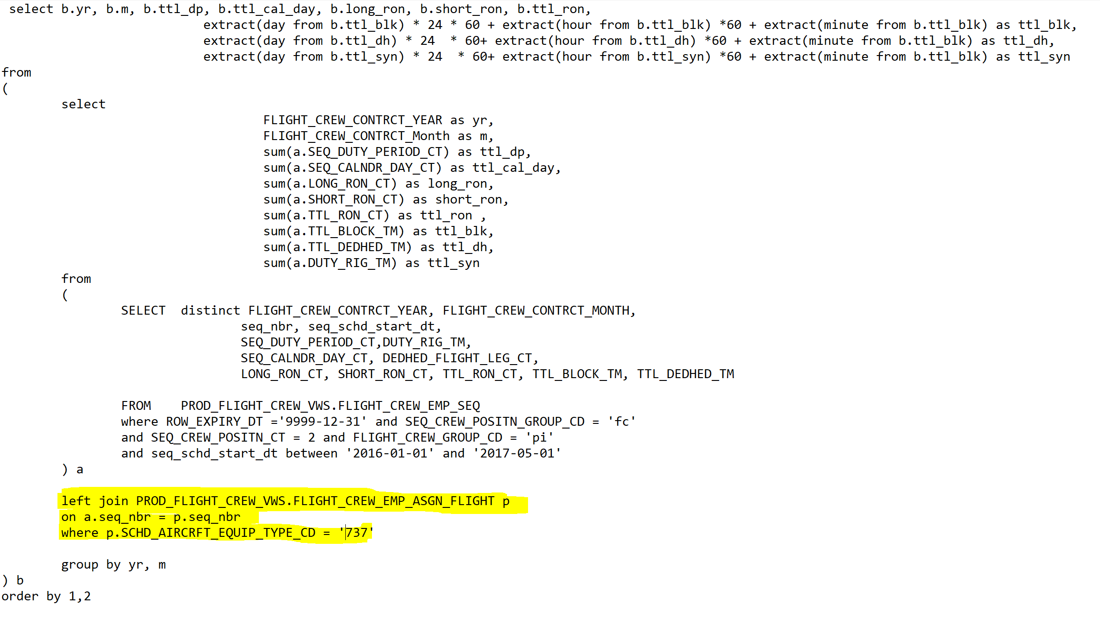
Query 2: Extraction of actual crew operations metrics
Tables used: FLIGHT_CREW_PAIRED_SEQ
FLIGHT_CREW_EMP_ASGN_FLIGHT
Parameters extracted
Conditions specified in Where clause
Variables created and format modified
Left join

Slide 11
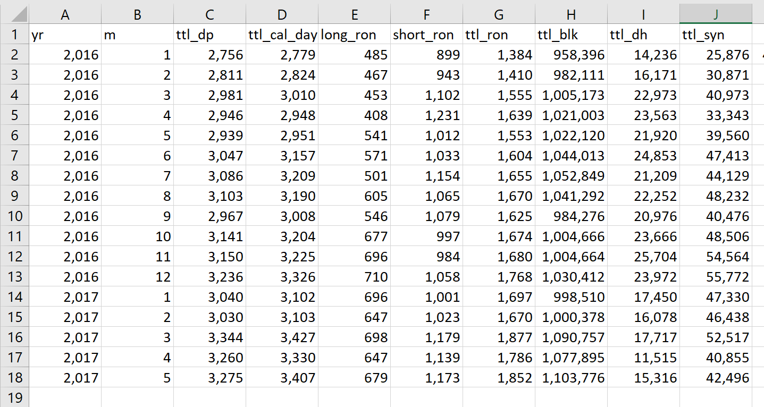
Extracted data - Planned

Slide 12
Phase 2: Data preparation and validation
Data Preparation
Remove duplicate values on ‘seq _num’ to get one row for a single flight trip
Data Validation - Against Mainframe Dataset – Live flight trip dashboard
Total number of flight trips – Advanced Excel
Check for missing values and change variable format if needed
Data Validation - Against Utilization Dataset- crew hourly pay data
Non matching cases- correct condition for TRIP_SELECT_TYPE_CD = (0,,2,3,4) for Lineholders

Slide 13
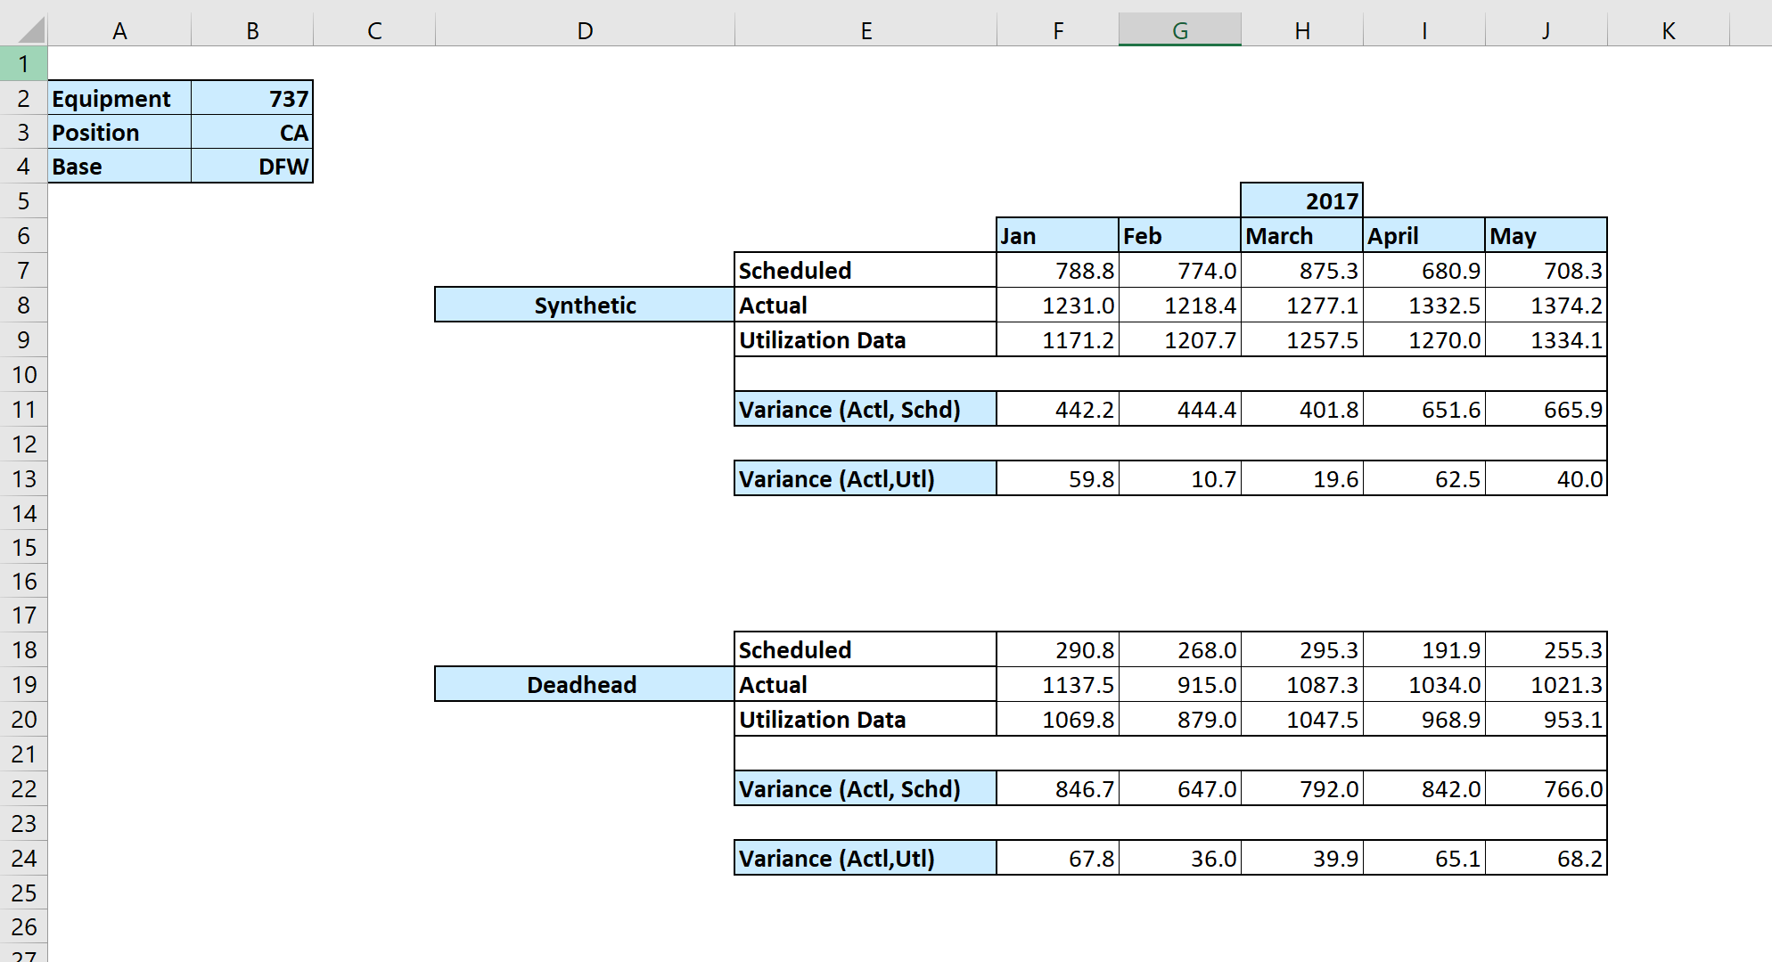
Phase 3: Exploratory analysis and visualization

Slide 14
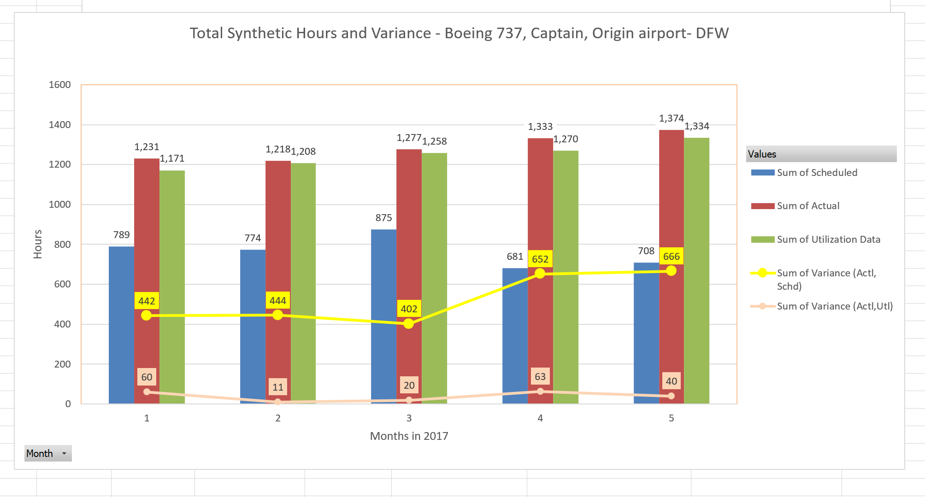
Phase 3: Exploratory analysis and visualization

Slide 15
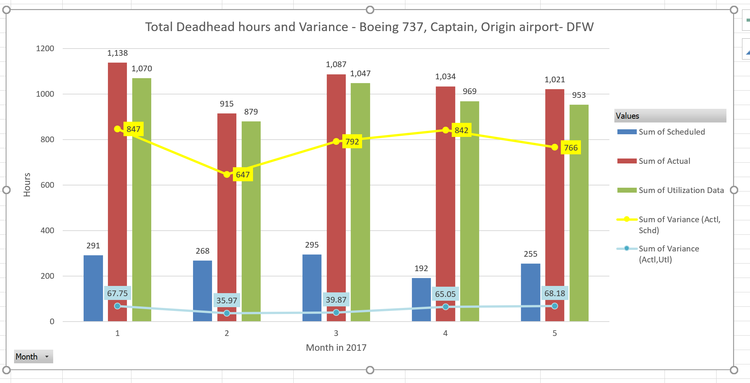
Phase 3: Exploratory analysis and visualization

Slide 16
Results
Variance between
Actual and Planned values of:
Actual and Utilization values of:
Synthetic
Range: 442- 666 hours
Deadhead
Range: 747-847 hours
Average: 554 hours
Average: 787 hours
Synthetic
Range: 11 – 63 hours
Deadhead
Range: 35- 68 hours
Average: 38.8 hours
Average: 55.3 hours

Slide 17
Conclusion
Results of variance analysis between Actual and planned metrics
Improvement in accuracy of metric forecasting by Operations Planning and Performance Team
Identify causes of increase in operational costs
Results of variance analysis between
Actual and Utilization metrics
Issue of data integrity and inhomogeneity within data infrastructure
Need to asses and analyze the data sources and entry methods of the system
Pinpoint target areas for operational performance improvement

Slide 18
Future Scope
Increase viability of analytical model
Including more factors like trip start time, seasonal effects and air traffic conditions within the data model
Develop strategy road to improve functional efficiency of crew operations
Provide data base solution by identifying causes of variance
Improve accuracy of analysis
Include statistical metrics like co-variance between operational parameters

Slide 19
Thank you

